Slide 1

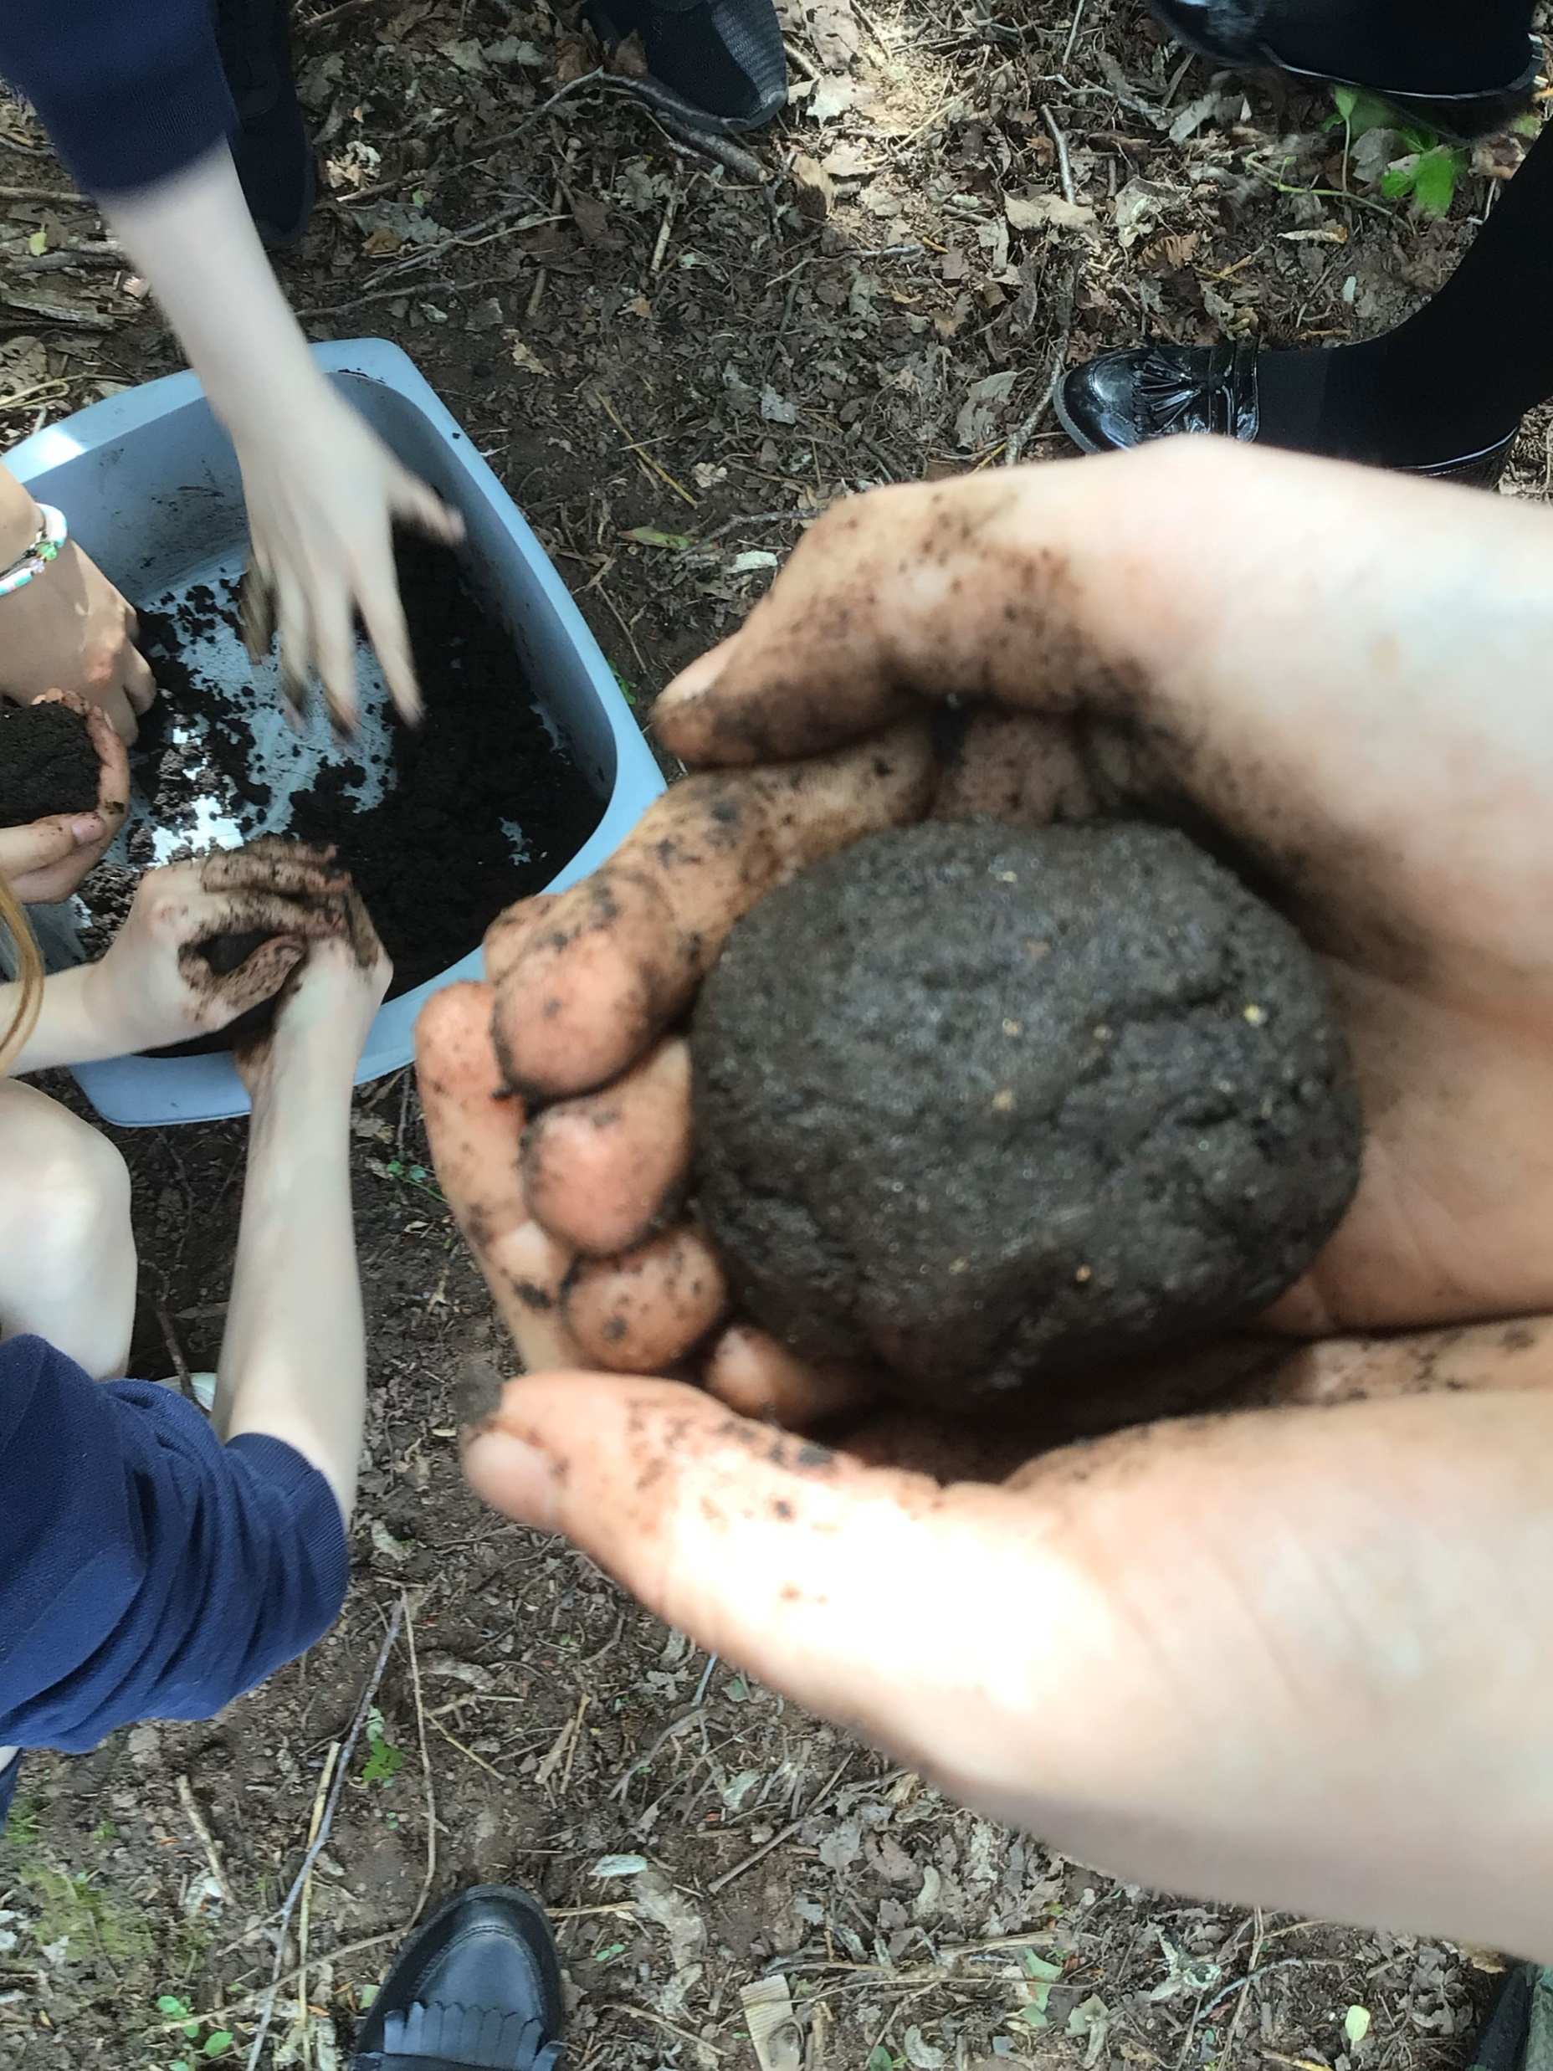



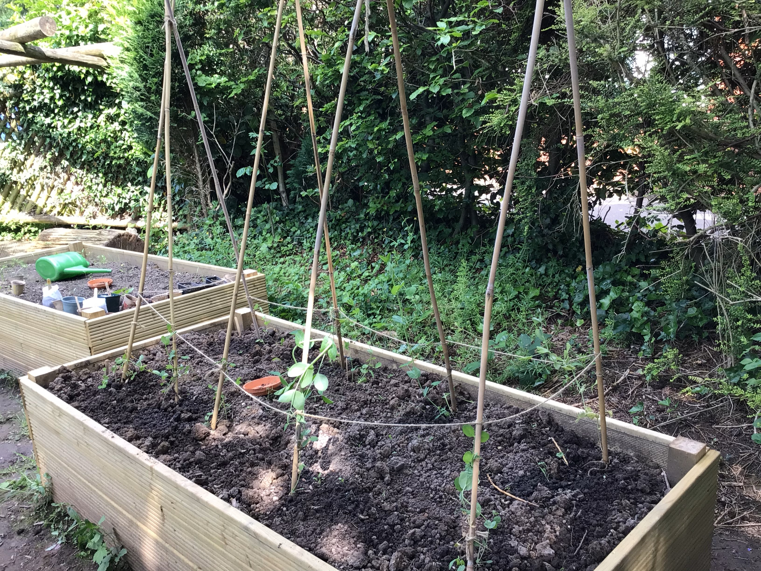
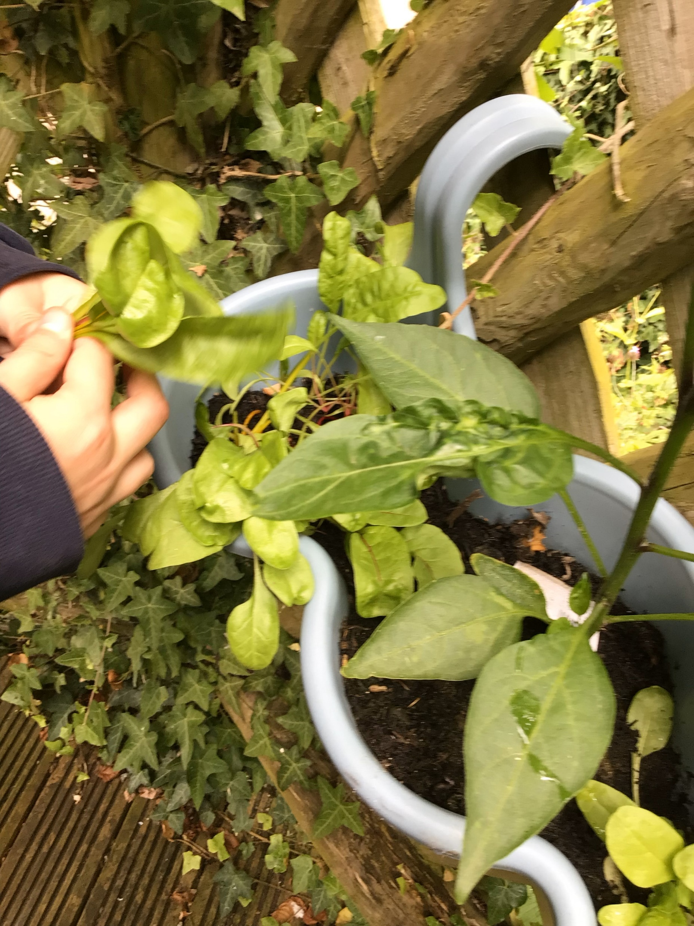
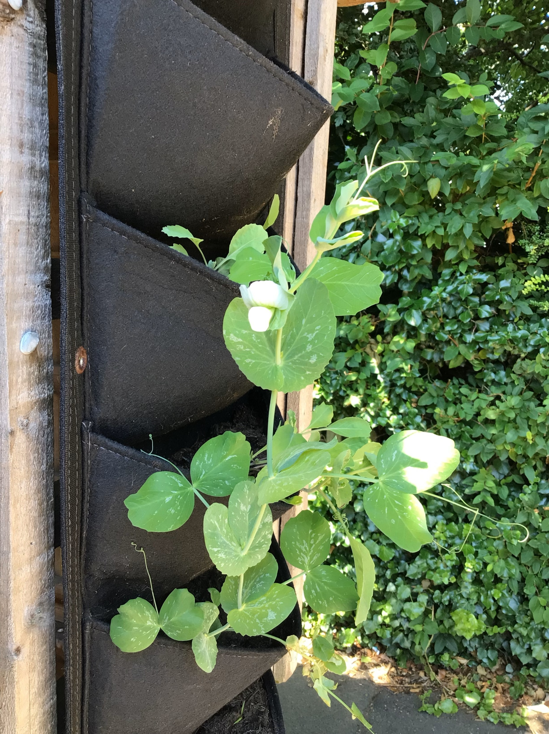
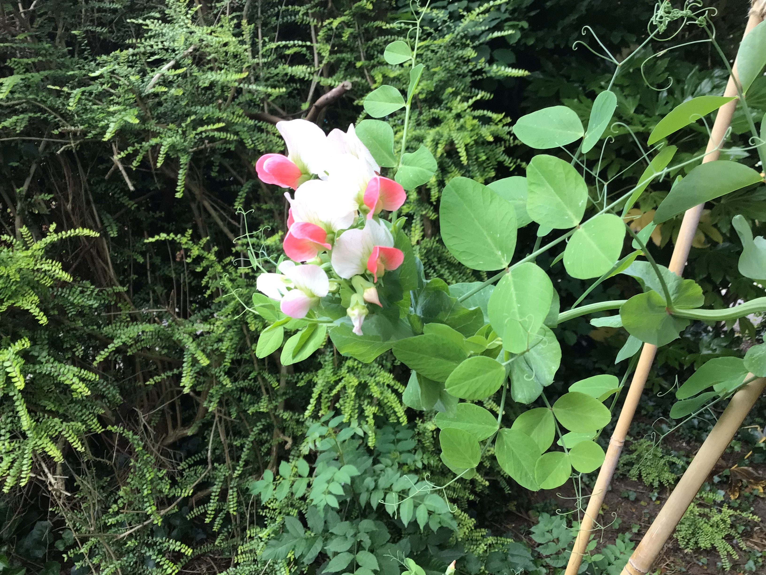
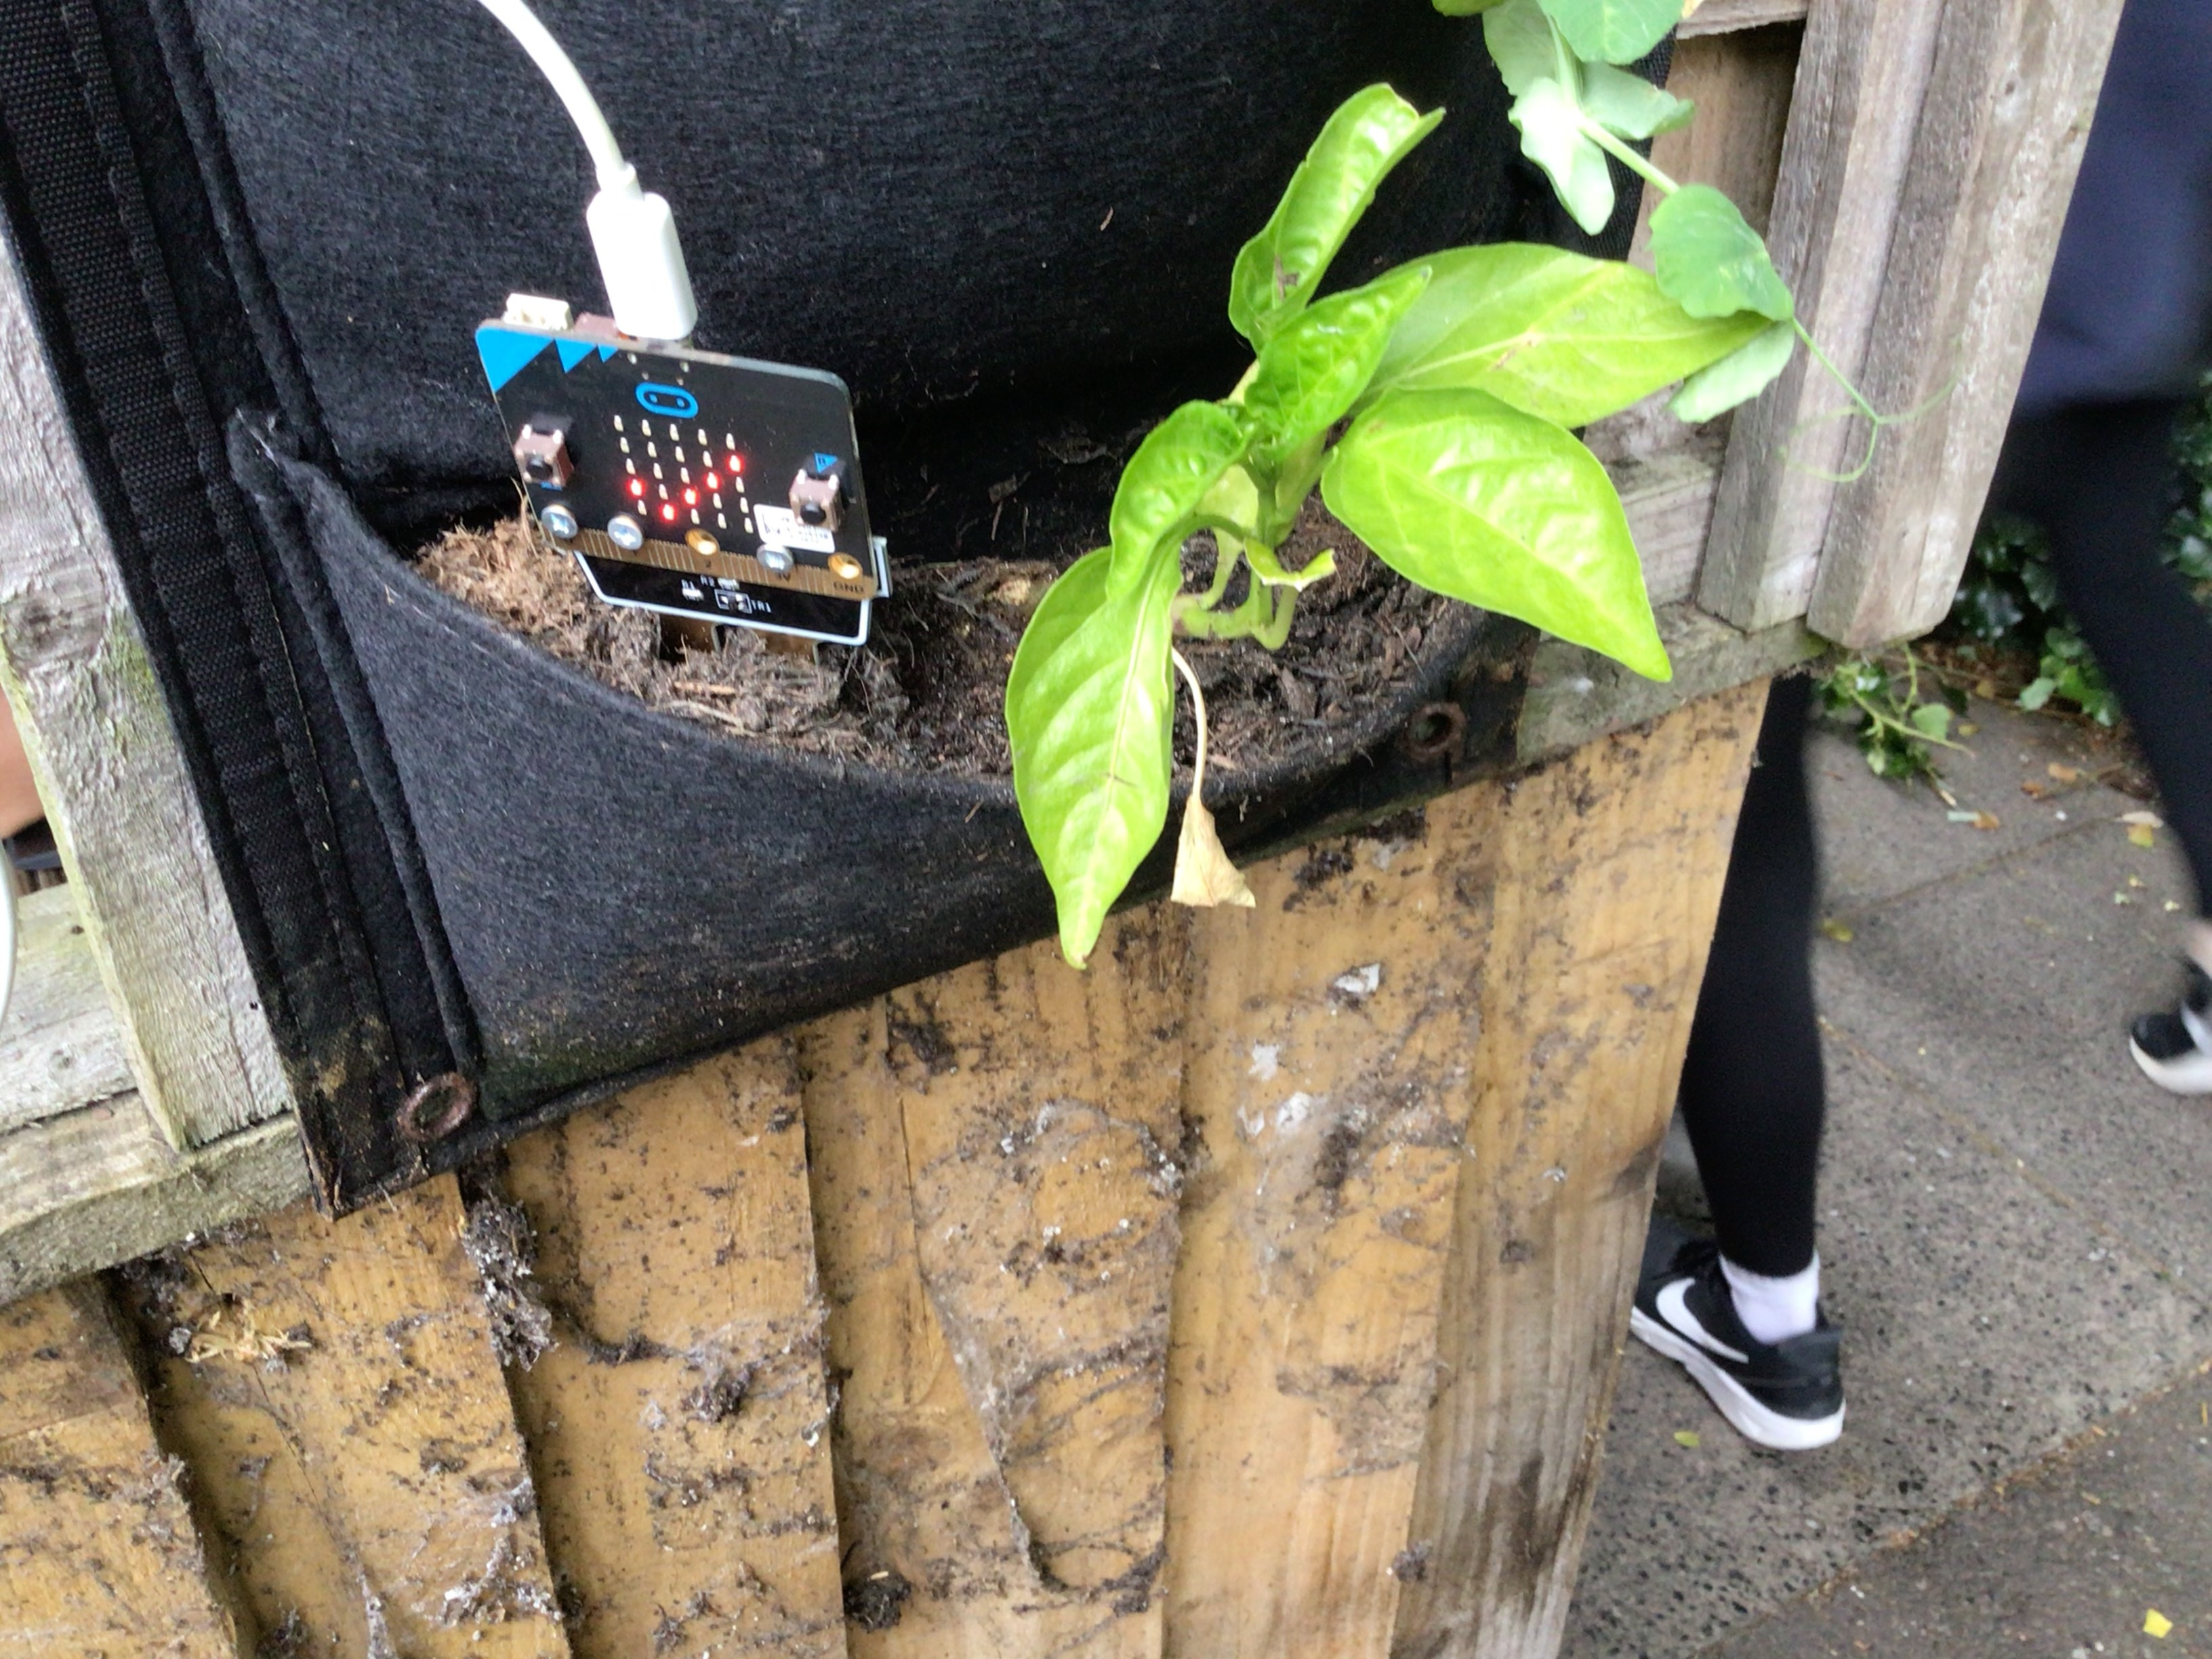
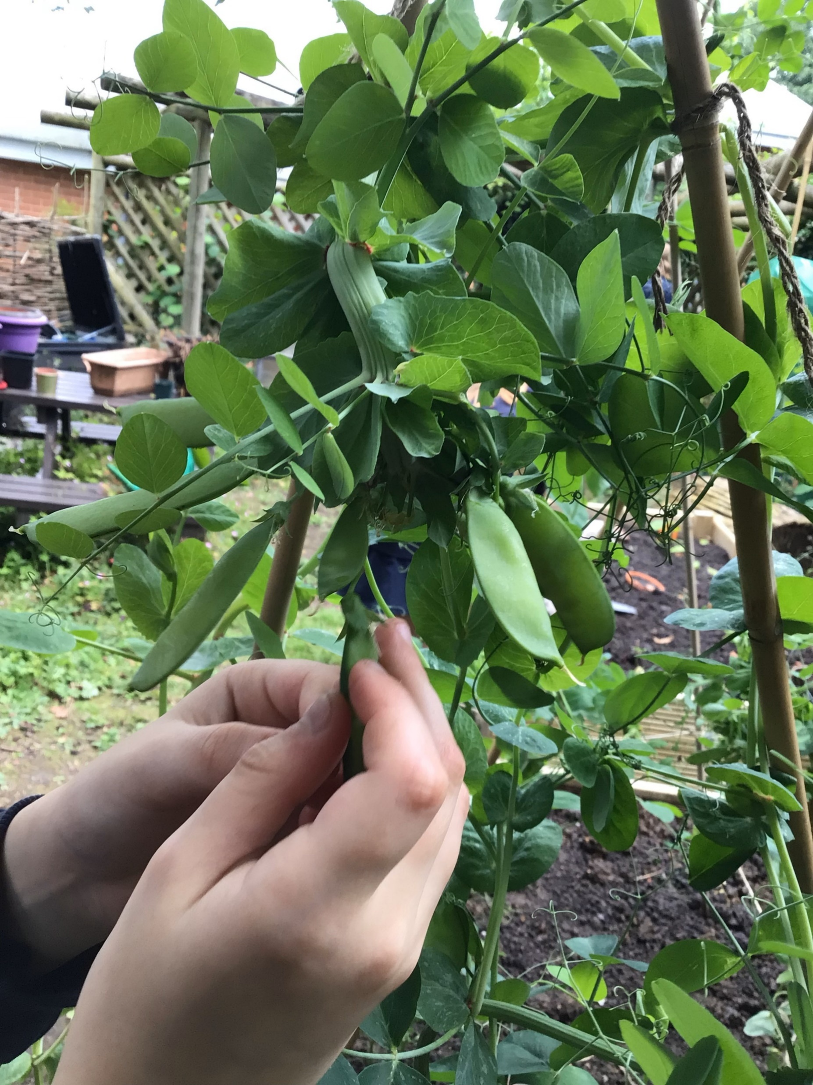
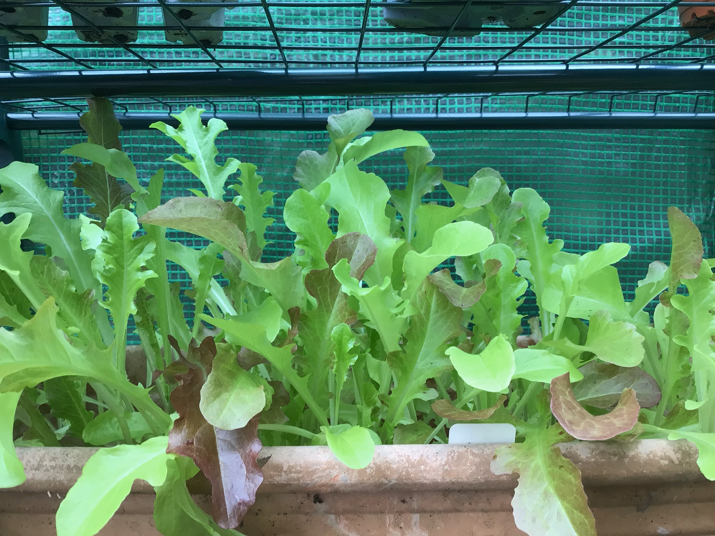
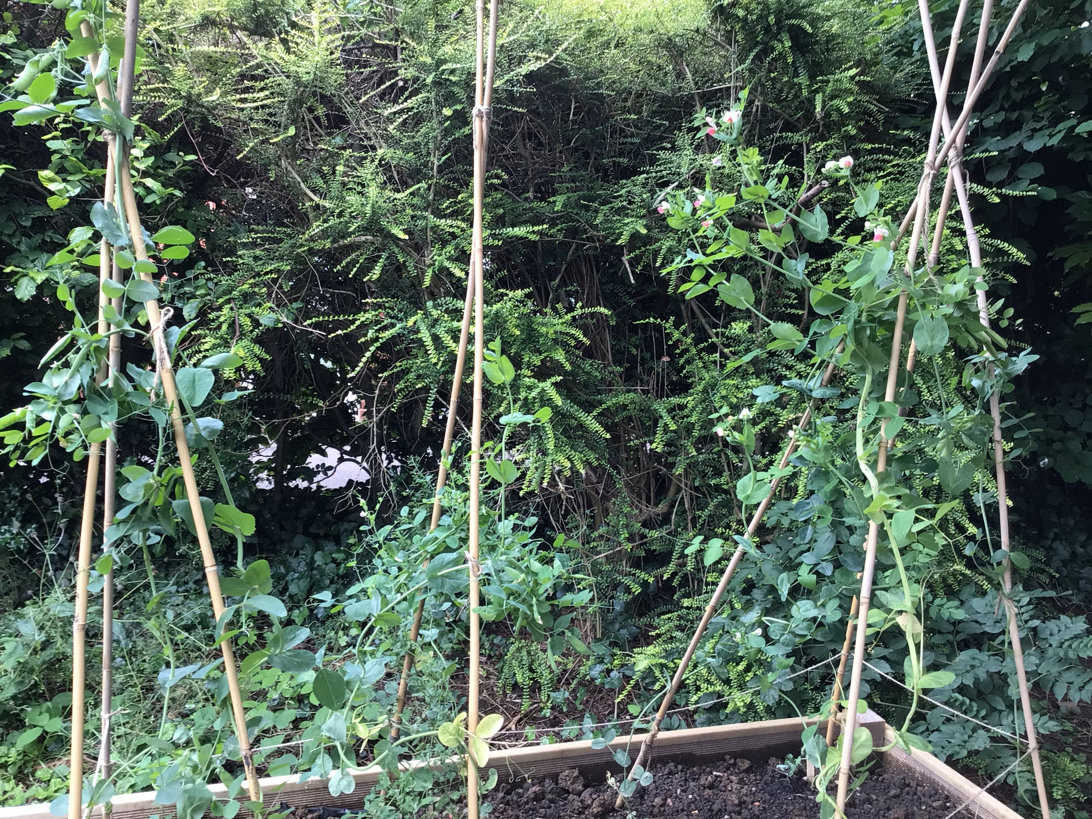

Investigating the Optimal Growing conditions for food to grow in our school.
School/college name Aston Fields Middle School
STEM partner organisation name: Portsmouth University;
Garden Organic
Your STEM partner logo here
Overview and aims
To investigate the optimal conditions required for organic fruit and vegetables to grow in the school environment. Pupils will gain a better understanding of what is possible and how we can help to reduce carbon emissions. We hope to achieve this by growing food that we can use in our school, by the kitchen and by pupils during cooking lessons. Overall, the project will allow them see that small local changes can have an impact and ultimately, how we can encourage others to grow their own food too.
May
A representative from LEAF education delivered a sustainability workshop to selected pupils in year 7. They discussed the importance of planting seeds and understanding how seeds grow and develop roots. Pupils then planted some seeds in sustainable pots. They then made seed bombs loaded with topsoil and wildflower seeds. The pupils had great fun throwing them around the green area in the jubilee garden.
April-July
We prepared the vertical and raised beds. Using the skills that we had learnt, we potted our seeds and put them in our greenhouse and inside the classroom. We monitored the plants and watered them. When they were ready, we planted out the seedlings into the different beds.
Pupils used moister sensors and their pH sensors to monitor the growth of the vegetables. These were then planted out and the pupils enjoyed watching them grow. Before the end of term pupils were able to harvest some of the plants and share them with the DT department and take some home.
September
our STEM partner, Catrina from Garden Organic, visited the school. She gave a presentation to the pupils about what the seed library does and why they are helping to conserve heritage vegetables that are not widely available. Pupils were shown how to save seeds from plants such as peas, beans and carrots. We were able to show the different plants that we had been growing and she was pleased to see that we still had plants to harvest. We put our new seed saving skills into practice and collected lots of seeds from the pea plants that we had.
Background information
This project builds on work that pupils carried out on testing the best conditions for growing different varieties of peas. The pupils found that Blackdown Blue pea grew successfully in our raised beds. The pupils also helped to train new recruits to the eco-STEM club about seed germination, how to make structures to support the growth of plants and how to monitor the conditions that they are grown in. The pupils also found that Pea Rosa grew successfully in pots. They were able to save seeds from both peas. To move the project forward, the pupils will use their skills to test which fruit and vegetables they can grow in our school ground. To help us do this, Garden Organic have donated The Mayor of Leicester peas from their heritage seed library; these peas are not widely available, and the pupils will aim to collect seeds, to return to the library.
Research and investigations undertaken
February
Our STEM partner gave a talk to the pupils about the importance of green walls and edible planters to pupils in the club. She informed the pupils about the benefits of growing food in schools such as promoting healthy eat and broadening pupils' skills. She also discussed the benefits of increasing pupils' environmental awareness. She explained that vertical beds are being successfully used around the world such as in New York and how pupils can go from being consumers to being producers.
March
6 pupils had the opportunity to visit the Royal Society to present the work that they have been completing in eco-STEM club. To prepare, all pupils that attend eco-STEM club have been programming micorbits, using pH probes and looking at the carbon footprint of the food that we eat. This was so that the 6 pupils representing us had some hands-on activities that could be used in the workshop. Whilst there, pupils were taught valuable presentation skills before going into their workshop and interacting with pupils from other schools, teachers and research fellows. We had a lovely day out and the pupils were very excited to continue their project on testing which fruit and vegetables are possible to grow in our school environment.
Results and conclusion
We found that we could successfully grow lettuce, spinach, swish chard, peas, chilies and herbs in our vertical beds. We also found that the raised beds gave us the largest yield of peas. We were given one packed of seed from Garden Organic and we were delighted to return a lot more seeds to the library. Catrina expressed to us how the seeds we have returned are helping us to reduce our carbon footprint.
Next steps
Harvest the vegetables that we have currently growing. We will used the seeds that we have saved in the next growing season. Train new pupils that would like to be eco monitors.

